Slide 1

Customer Churn Prediction in Telecom Industry
Presented by
C Vinod Kumar [Batch: 31 ID: 1442]
PHD Project presentation
I NSOFE
Jan 27, 2018

Slide 2
OUTLINE
Introduction
Business Challenges
System Overview
Data Pre-processing, Analysis
Methodology
Results
Conclusion

Slide 3
Introduction
Mobile Carriers Currents focus on customer retention
Churn(Definition): Customers Stop Subscribing to a Service
Churn prediction & prevention becomes a crucial for Business Analytic applications
Good churn prediction system identifies Potential Churners & Forecast for a longer period
Data Analysis uses for modelling relationship between subscribers
“ Goal is to create an analytical and ML model to predict the customer churn in a telecom company based on the quantitative and qualitative features”

Slide 4
Business Challenges
Customers compromised of different segments with average spending range (Total Charges) from ₹2 to ₹4992
If one subscriber churns he can influence other friends & family members
Early Churn phenomenon
Predicting patterns for churn and non-churn
Because of Churn long term revenue loss, to get new customers promotion cost will increase
The company observed that alarming number of customers exit when their contracts expire while it is getting increasingly difficult to acquire new customers.
“To solve these we Use R, Machine learning classification algorithms like Logistic regression, Decision Trees, Naïve Bayes, Random forest, SVM etc.,.”

Slide 5
Data Set
Data Characteristics:
Telecom Customers historic data from 2006 to 2012 of Maharashtra state(India)
The datasets are provided as cited below for the analysis:
Input features:
Demographics Data : Household ID, Country, State, Retired, Has Partner, Has Dependents, Education, Gender
Customer account information : Customer ID, Base Charges, DOC, Total Charges, DOE, Electronic Billing, Contract Type, Payment Method
Data of Services Opted For : Customer ID, Type Of Service, Service Details
Churn Data : Customer ID, Churn
Derived features:
From each table we derived new required features like
Data of Services Opted For : Device Protection, Has Phone Service, Internet Service Category,
Multiple Lines, Online Backup, Online Security, Streaming Movies,
Streaming Television, Technical Support
Customer account information : Tenure group (to classify number of months revenue with Churn frequency)

Slide 6


Purpose
Evaluation Metrics
We took Precision-Recall metric to evaluate classifier output quality.
High scores for both show’s that the classifier is returning accurate results, as well as returning a majority of all positive results (high recall)
Precision (P) is defined as the number of true positives (TP) over the number of true positives plus the number of false positives (FP).
Recall (R) is defined as the number of true positives (TP) over the number of true positives plus the number of false negatives (FN).

Slide 7
System Overview
Data Pre-processing, Analysis
Data Characteristics
Data Observations
Handling missing values
Feature Engineering
Correlation
Selecting Features

Slide 8
Data (Observations & Challenges)
Train data
Given data has four .cvs files we need to merge them
Demographics Data (5298 rows, 8 columns)
Customer account information(5298 row, 8 columns)
Train Data (5298 rows, 2 columns)
But in “Data of Services Opted For.csv” having (47682 row, 3 columns), Each customer has addition 9 features which are represented in column
To solve this we reshaped data using dcast command, Then we merged all four .csv files to Data frame
Test data
Given data has four .cvs files we need to merge them
Demographics Data (1769 rows, 8 columns)
Customer account information(1769 row, 8 columns)
Test Data (1769 rows, 1 columns)
But in “Data of Services Opted For.csv” having (15921 row, 3 columns), Each customer has addition 9 features which are represented in column
To solve this we reshaped data using dcast command, Then we merged all four .csv files to Data frame

Slide 9
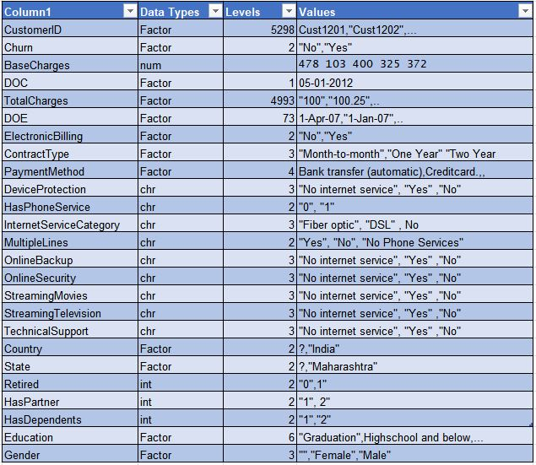
DATA Characteristics
Train Data is a data frame having
5298 rows , 25 columns
24 were Independent Variables
1 Dependent Variable
Churn ( Whether the customer churned or not (Yes or No))
Test Data is a data frame having
1769 rows , 24 columns
24 were Independent Variables

Slide 10
Data
Observations & Challenges
Columns such as State, Country, Total Charges, Contract Type etc., has “?” , “MISSINGVAL” , Blank Space, “NA” as NA
So, We replaced “?” , “MISSINGVAL” , Blank Space, “NA” with NA
Columns Device Protection, HasPhoneService,InternetServiceCategory,MultipleLines,OnlineBackup
Online Security, Streaming Movies, Streaming Television, Technical Support are showing as “Character”
So , Converted data type to factors
Columns “Has Partner”, “Has Dependents” - has “1” and “2” represents whether the customer has dependents or not , Partner or not
So, We recoded them to ( 1-Yes; 2-No)
Similarly for “Has Phone Service” and “Retired” has “0” and “1” we renames as (0- No; 1-Yes)
We drop unnecessary levels in table

Slide 11
Data
Handling missing values
Overall we have 42 missing values in training data(7%), in test data 14 missing values
Total charges have 10 missing values we replaced with 0, because missing values in that column occurred because when they joined the service on the same we collected data so Total charges for those customers should be 0
Other columns we imputed using central imputation
Feature Engineering:
By using library(lubridate) formatted date columns
Subtracted DOE (Date of entry as customer) from DOC(data collected date) calculated age of the customer with service provider and created new column
Total charges ranges from ₹2 to ₹4992 so we took another column binning them
Base charges range from ₹90 to ₹500 so we took another column binning them

Slide 12
Visualizations

Slide 13
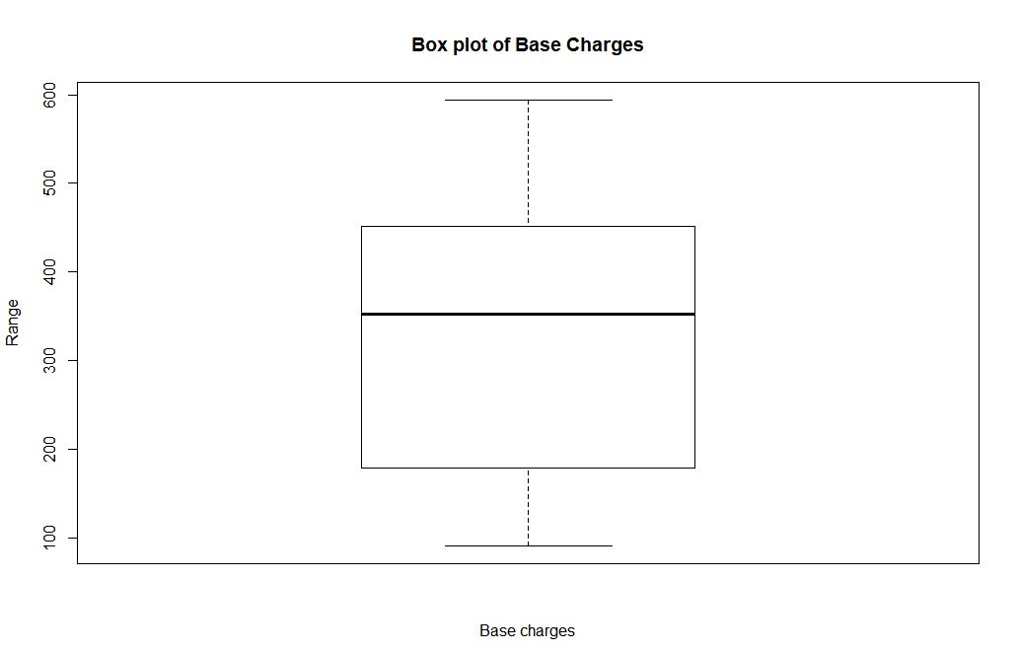

Slide 14
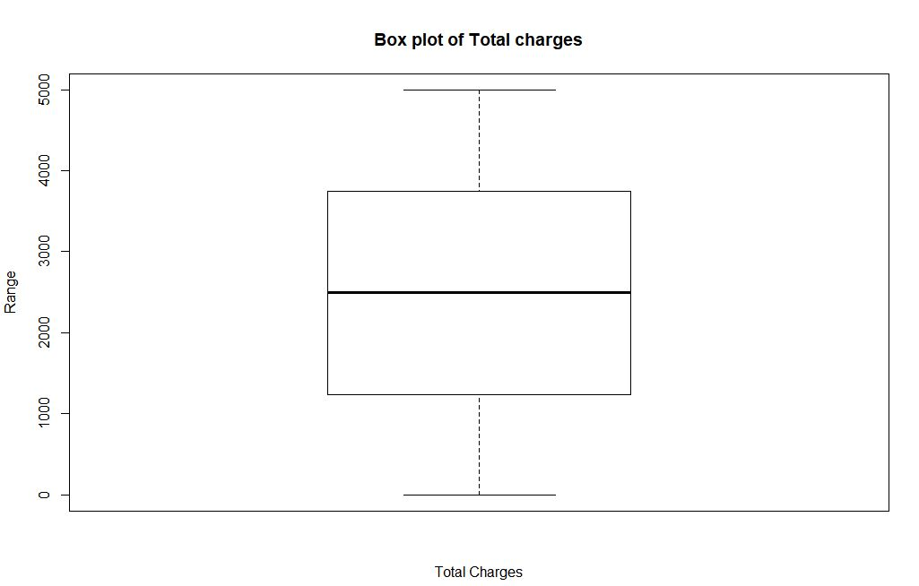

Slide 15
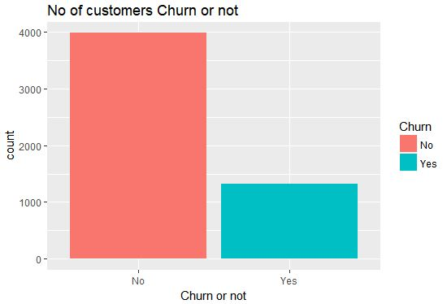

Slide 16
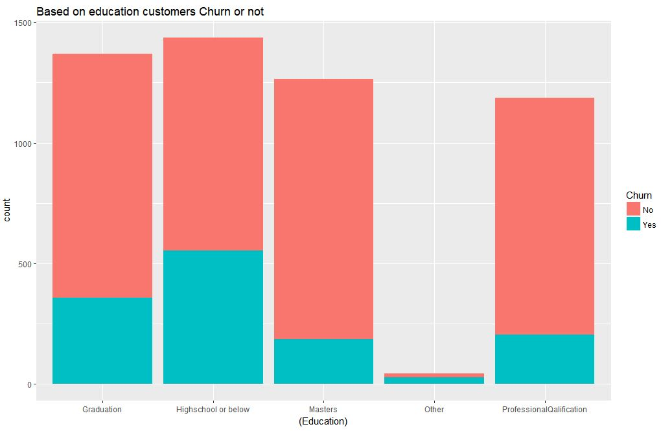

Slide 17
Data
Selecting features
Feature like dimensions Customer ID, State, Country have singularities so we can omit those columns
We took age of customer as Tenure column so we can omit DOC an DOE
Similarly we can omit Base charges, we already binned Base charges range
Now we have 21 Variables 1 numeric and all are factorial
Train and Test data:
To Build model we took 80 and 20 proportion of data as training and validation
Train data (3681 21)
Validation data(1617 21)
Test data(1769 20)
Now our data is ready to build our model

Slide 18
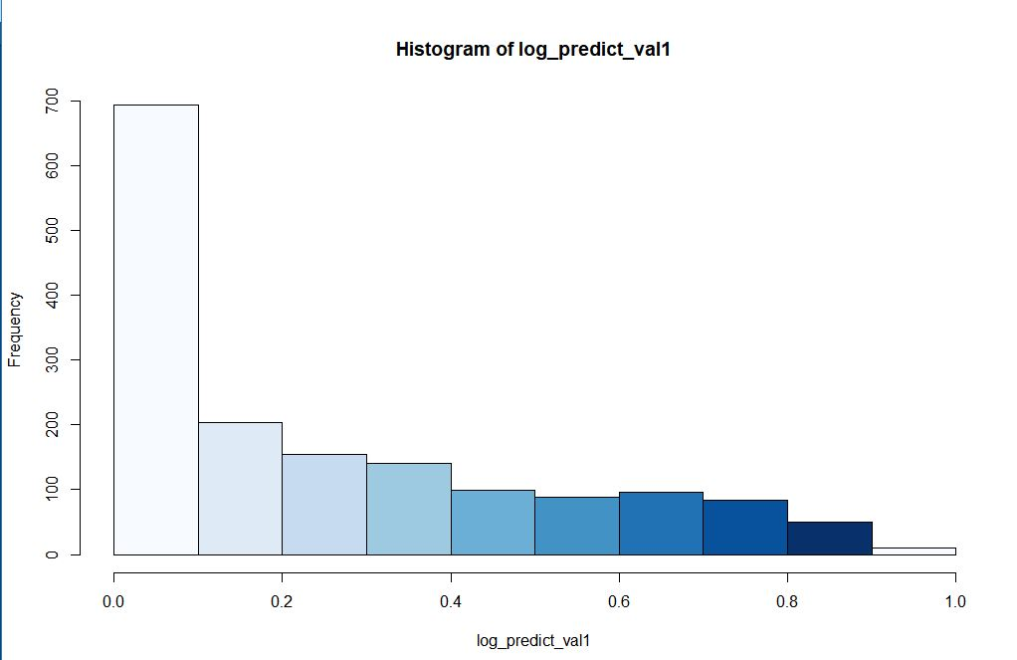
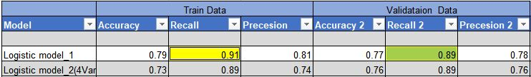
Model building
Logistic regression model:
I use Logistic regression model
At Threshold > 0.3 gave me accurate results
I did Chisq test on logistic model gave vaiable significance

Slide 19
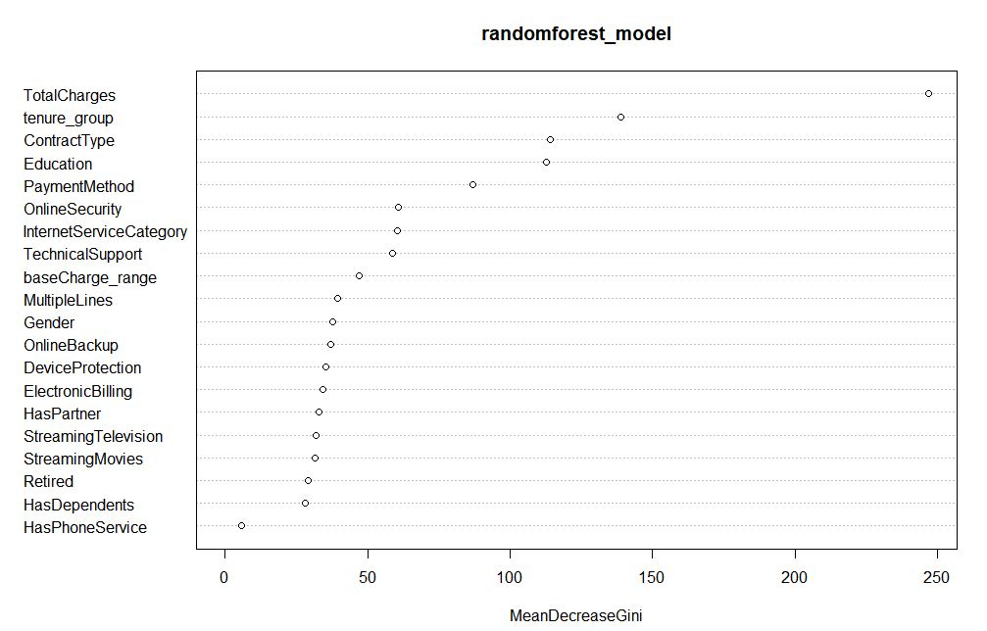
Model building
Random forest model:
I use Random forest model
At ntrees = 100 and mtry = 3 gave me accurate results
Plotted variable importance using random forest

Slide 20
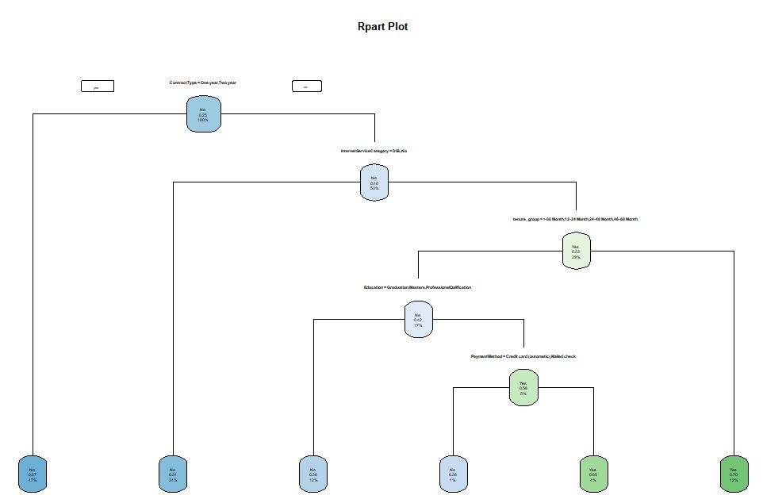
Model building
Rpart model:
I use Rpart model
Variables actually used in tree construction: Contract Type ,
Education,
Internet Service Category
Payment Method ,
Tenure _ group

Slide 21
Model building
SVM :
I use SVM with Kernal="linear" cost = 1 gave me accurate results with number of Support Vectors = 1647
Naïve bayes Model:
I use Naïve Bayes Model and predicted Churn

Slide 22
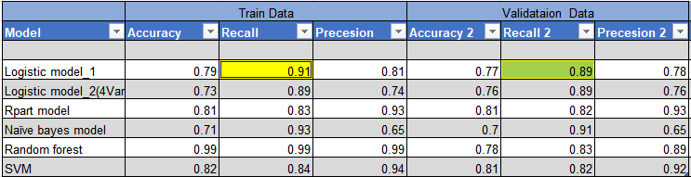
Results

Slide 23
Summary
As Per analysis there more churn in Contract type of month – month plan
There are more early Churn frequency in students and bachelors (who are high school and below, Graduation.
Overall churn percentage is 24%, We observed that Month to Month Contract type customers are more compared to others i.e., 21%
So Telecom companies should concentrate on more on monthly plans
We got best accurate results in Logistic Regression with recall of 81% and accuracy 76%

Slide 24
Thank you

